Slide 1



Fusing Vision and Language Models for
Radiographic Diagnostics: A Proof of Concept
Bahenda Yvon Dylan Ntegano
Supervisor: Prof. Federico Cabitza, University of Milano-Bicocca
Bachelor of Artificial Intelligence
PAVIA 2025
Notes:
Good afternoon, everyone. My name is Bahenda Yvon Dylan Ntegano, and today I will be presenting my Bachelor's thesis, 'Fusing Vision and Language Models for Radiographic Diagnostics: A Proof of Concept.' This research was conducted under the supervision of Professor Federico Cabitza.

Slide 2
Presentation Outline
The Problem & The Goal
Introduction & Hypothesis
The Findings & Analysis
Results from both cases
Comparative Discussion
The Experimental Design
Methodology: Cases & Models
Implementation & Setup
The Takeaways
Conclusions & Future Works

Slide 3
The Problem & The Goal

Slide 4
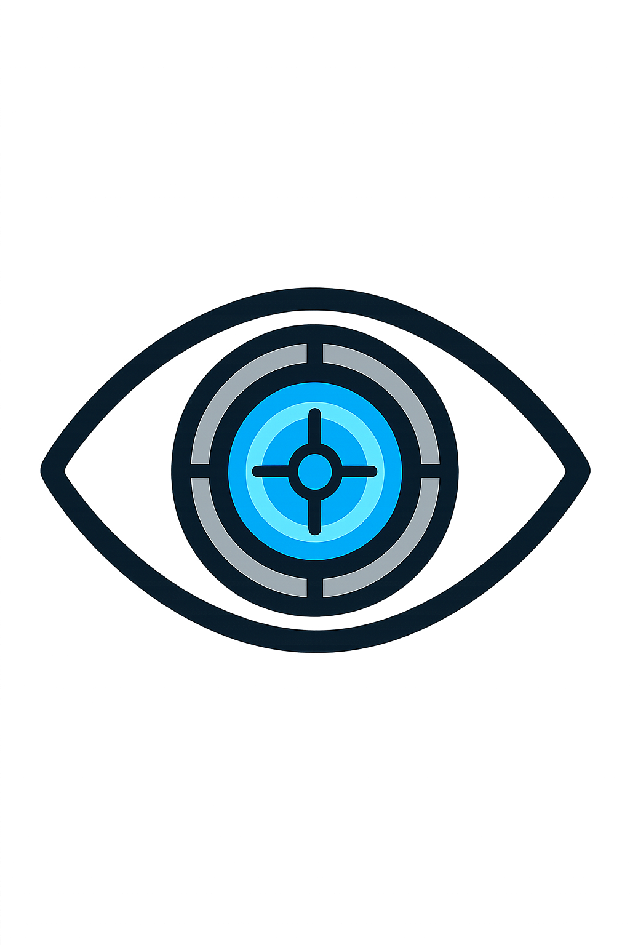
Introduction & Motivation
Problem:
Clinical decisions are made based on multiple data types (images, text).
Most AI systems process these data in isolation.
Why it Matters:
Radiographic data is growing in complexity and volume.
There is a need for efficient and accurate diagnostic support.
Notes:
In medical diagnostics, radiology in particular, clinicians integrate information from various sources, like X-ray images and textual reports, to make a diagnosis. However, many current AI systems operate on this data in isolation. This thesis addresses this gap by exploring how fusing vision and language models can enhance diagnostic accuracy, to replicate this multimodal approach that is present in clinical conditions.
This is important because radiographic data is increasingly growing both in terms of complexity and volumes, and this creates a need for faster and more accurate decision support especially in low-resource or fast-paced clinical environments.

Slide 5
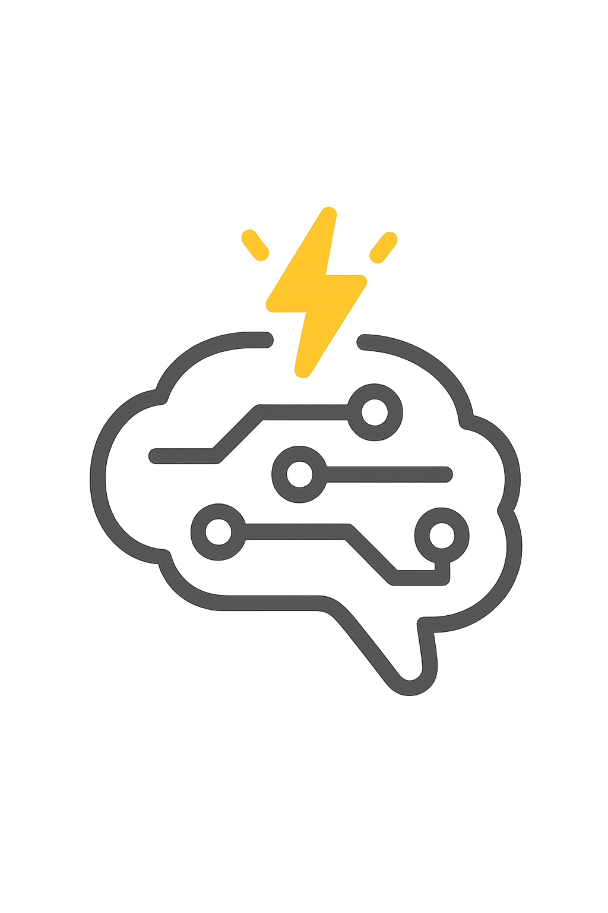
Research Question & Objectives
Central Hypothesis: Combining visual and textual information leads to improved diagnostic performance in medical imaging tasks.
Objectives:
Implement unimodal baselines (Vision Transformer and BERT-based models).
Compare various multimodal fusion techniques (concatenation, gating, cross-attention, and CLIP).
Assess the adaptability of these models across two different clinical cases.
Notes:
The core hypothesis of this thesis is whether combining images and text can lead to better diagnostic performance. To answer this, I set out to first establish baseline performances using single-modality models—Vision Transformer for the images and BERT-based models for the text, then to implement and compare different methods for fusing these modalities like concatenation, gating, attention, and CLIP, and finally, to test how well these models adapt and generalize to different medical imaging tasks.

Slide 6
The Experimental Design

Slide 7
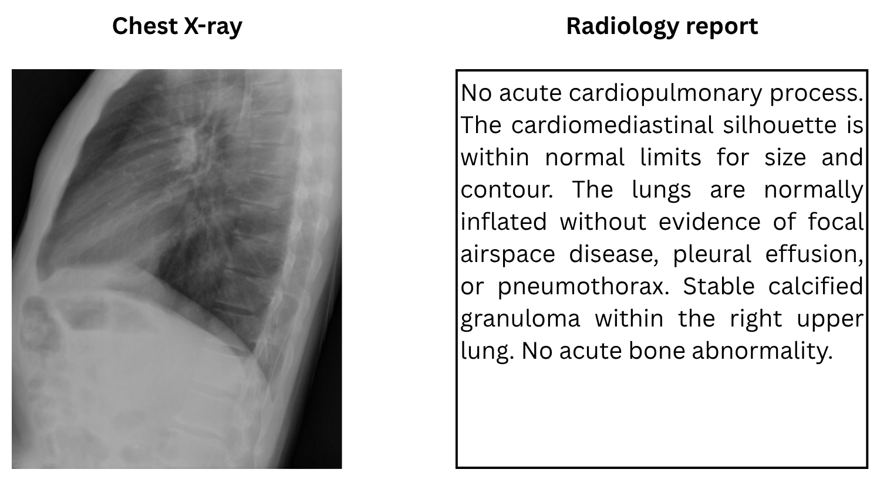
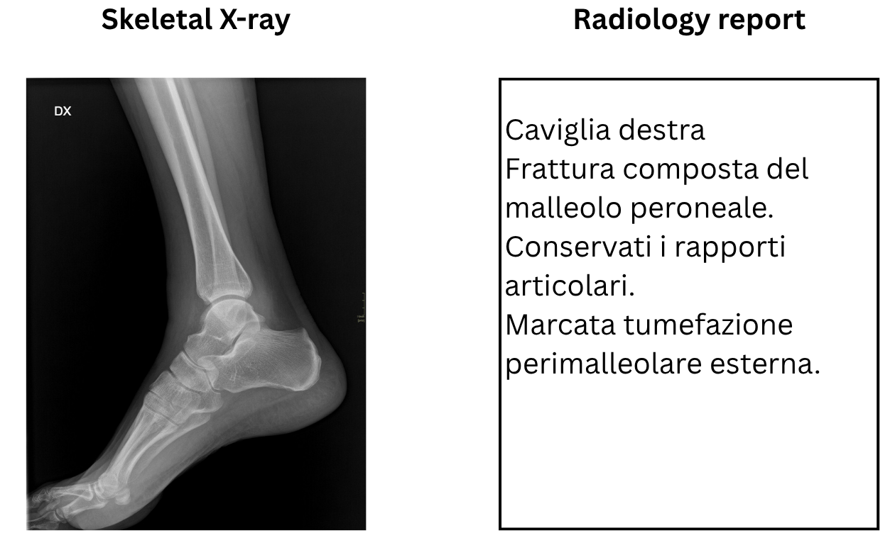
Methodology – A Tale of Two Clinical Cases
Case 1: Chest X-rays
Dataset: NLMCXR (public)
Task: Multi-label classification (14 labels)
Note: Imbalanced dataset
Case 2: Skeletal X-rays
Dataset: Gaetano Pini Orthopedic Institute
Task: Binary Fracture Detection
Note: Small dataset and in Italian
Notes:
To test my hypothesis, I used two distinct clinical cases. The first involves a large, public dataset of chest X-rays for a multi-label classification task. The second uses a smaller, real-world dataset from the Gaetano Pini Orthopedic Institute for a binary fracture detection task.
This two-case approach allowed me to evaluate the adaptability and generalizability of the models across tasks (multi-label or binary), languages (English or Italian), and clinical domains (thoracic and skeletal).

Slide 8
Methodology – The models
Vision Model: DeiT (Data-efficient Image Transformer), a lightweight Vision Transformer.
Language Model: TinyBERT, a distilled smaller version of BERT.
Multimodal Fusion:
Concatenation
Projection + Gating
Cross-attention
Joint Embedding: CLIP (Contrastive Language-Image Pre-training).
2021 Training data-efficient image transformers & distillation through attention
2020 TinyBERT: Distilling BERT for Natural Language Understanding
2021 Learning Transferable Visual Models From Natural Language Supervision
Notes:
I chose lightweight, distilled transformer models, DeiT for images and TinyBERT for text, to ensure efficiency. For combining the data, I explored several fusion techniques, from a simple concatenation to more complex methods like gating and cross-attention. I also investigated CLIP, a model that learns joint embeddings for images and text.
Deit introduced by Touvron et al in 2021. TinyBERT introduced by Jiao et al in 2020. OpenAI’s CLIP.

Slide 9
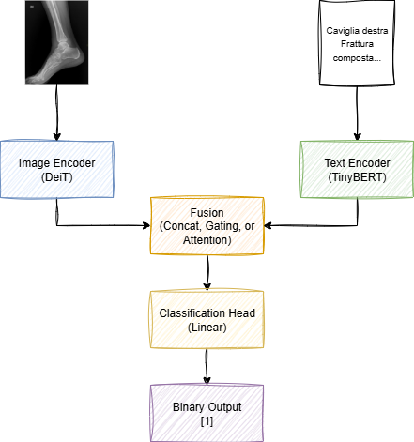
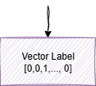
Implementation & Experimental Setup
Feature Extractors:
Pre-trained Encoders (DeiT, TinyBERT, CLIP) were kept frozen.
Trainable Layers:
Fusion layers and classification head.
Dataset Split:
80 / 10 / 10 split as a fixed ratio.
Loss:
Binary Cross-Entropy with Logits.
Epoch: 10
Skeletal Case
Chest Case
Notes:
A crucial part of the experimental setup was that the main encoders, DeiT and TinyBERT, were kept frozen. This means I used them as powerful, pre-trained feature extractors. The only parts of the model that were trained were the fusion layers and a custom classification head. This head is a small multi-layer perceptron that takes the combined features and maps them to the final diagnostic output—14 labels for the chest X-ray case, and a single binary output for the skeletal fracture case. This setup ensures that we are primarily evaluating the effectiveness of the fusion strategy itself.
To give you a quick look under the hood at the technical details, I used a standard 80/10/10 split for training, validation, and testing across both cases to ensure robust evaluation.
On the training side, Binary Cross-Entropy was the natural choice for the loss function, as it’s suitable for both multi-label and binary classification. To respect the computational constraints of working in Google Colab, training ran for a modest 10 epochs. Most importantly, these parameters were kept consistent across the experiments to ensure that all comparisons were fair and focused on the fusion performance itself.

Slide 10
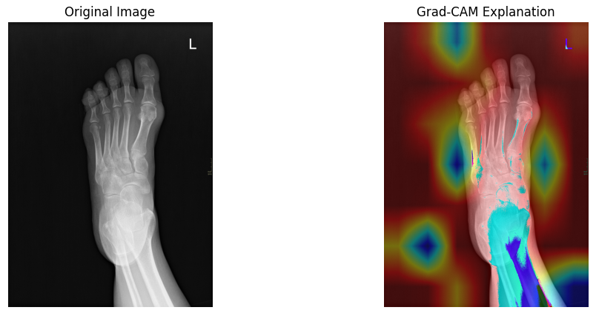
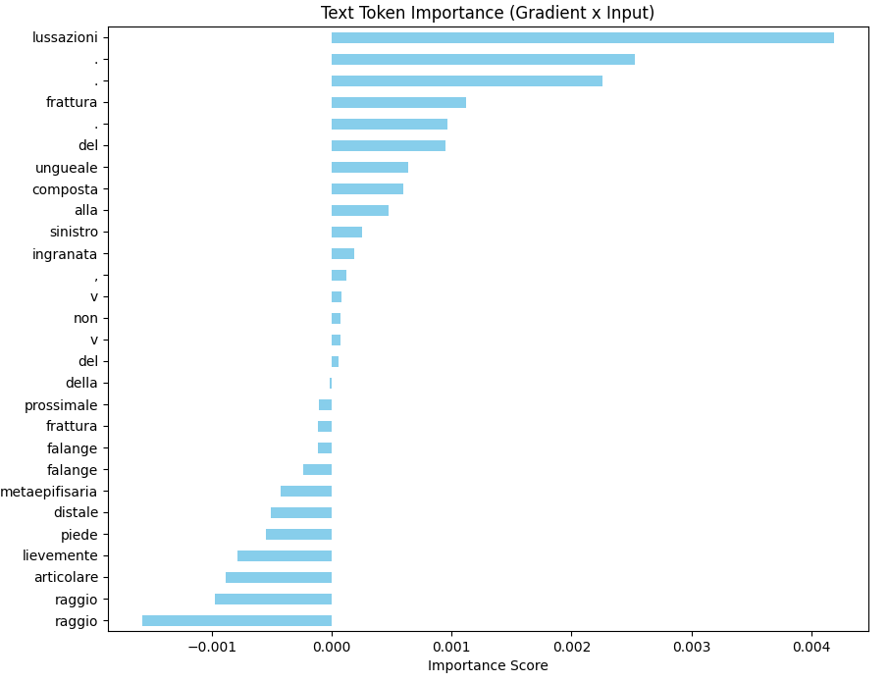
Adherence to the CHAMAI Checklist
Use case:
Intended User: Radiologists
Purpose: A decision support tool for augmenting, not replacing, clinical judgement.
Development Pipeline:
Transparency: All steps were documented in the thesis and the code will be made publicly available.
Assessment Procedure:
Metrics: A comprehensive set of metrics was used (AUROC, F1, MCC, Brier score for calibration).
Explainability: Used Grad-CAM for visual explanations and gradient-based methods for text token importance.
2021 The need to separate the wheat from the chaff in medical informatics: Introducing a comprehensive checklist for the (self)-assessment of medical AI studies
Notes:
To ensure the research was transparent, robust, and reproducible, I followed the principles of the CHAMAI checklist for medical AI. This meant clearly defining the use case as a decision support tool for radiologists. I established a consistent development pipeline across both clinical cases to ensure fair comparisons. Finally, the assessment procedure used a comprehensive set of metrics, a fixed data split for reproducibility, and included explainability techniques to interpret the model's decisions. Mention the white-box paradox.

Slide 11
The Findings & Analysis

Slide 12
Results – Chest X-ray Case
CLIP demonstrates the most stable and highest overall performance.
Notes:
In the chest X-ray case, the results were clear: multimodal approaches consistently performed better. CLIP, in particular, demonstrated the highest performance across most metrics. Interestingly, the language-only model outperformed the vision-only model, highlighting the rich information contained in the textual reports.
Low Brier Scores -> Model results are reliable
Fixed threshold should be changed -> adaptable per label

Slide 13
Results – Skeletal X-ray Case
Simpler task allows models to achieve near-perfect performance.
Results should be interpreted with caution due to the very small test set size.
Notes:
The skeletal X-ray case further validated these findings. The cross-attention fusion method achieved perfect scores, though this should be interpreted with caution due to the small test set. Notably, the language model, TinyBERT, performed remarkably well, even though it was not specifically trained on Italian medical text, demonstrating its generalization capabilities.

Slide 14
Comparative Discussion
Consistent Trend: Fusion of vision and language improves diagnostic performance.
Robustness of CLIP: Showed strong, generalizable performance across both clinical domains.
Promise of Gating: A good trade-off between performance and simplicity.
Insight: Clinical text is highly informative, even when short.
Notes:
Comparing both cases, a clear trend emerges: fusing vision and language consistently enhances diagnostic accuracy. CLIP stands out for its robustness and adaptability. The gating mechanism also proves to be a strong candidate, offering a great trade-off between performance and simplicity. A key takeaway is the immense value of clinical text in these diagnostic tasks.

Slide 15
The Takeaways

Slide 16
Limitations & Future Works
Limitations:
Frozen models: Due to limited computational resources, limiting their capacity for domain adaptation.
Small and imbalanced datasets: Reducing the generalizability and applicability of the findings.
Lack of external validation: Robustness was not tested for.
Future Works:
Fine-tuning the models or using domain-specific models.
Including Reliability metrics like the Expected Calibration Error (ECE) and the Expected Calibration Index (ECI).
Richer outputs, like generating the report.
Build a clinically deployable multimodal decision support system.
2023 Towards a rigorous calibration assessment framework: advancements in metrics, methods, and use.
Notes:
I acknowledge the limitations of this work, such as the use of frozen models and the size of the datasets. No hyperparameter tuning. Only diagnosis as output.
For future work, I suggest fine-tuning these models on larger, more specific medical datasets. There is also potential to develop systems that not only classify but also assist in generating reports, and to further improve the transparency of these models using explainable AI techniques.

Slide 17
Conclusion
Hypothesis Proven: Fusing visual and textual information improves diagnostic performance.
Key Contributions:
Successful implementations and comparison of various fusion techniques.
Demonstration of the adaptability of these models across different clinical scenarios.
This work is a “proof of concept” and lays the groundwork for future development.
Notes:
In conclusion, this thesis successfully demonstrates that combining X-ray images and radiology reports improves diagnostic performance. My work provides a systematic comparison of different fusion strategies and confirms their adaptability. While this is a proof of concept, it lays the groundwork for developing more advanced multimodal clinical decision support systems.

Slide 18
Thank You!
Fusing Vision and Language Models for
Radiographic Diagnostics: A Proof of Concept
Bahenda Yvon Dylan Ntegano
Supervisor: Prof. Federico Cabitza
Bachelor of Artificial Intelligence
PAVIA 2025

Slide 19
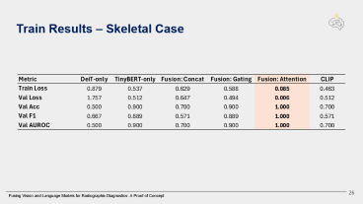
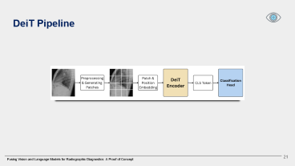
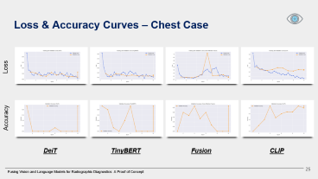
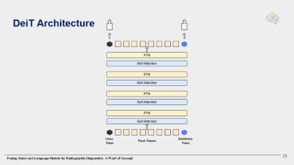
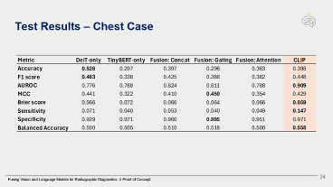
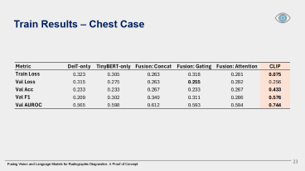
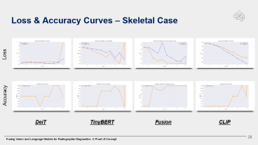
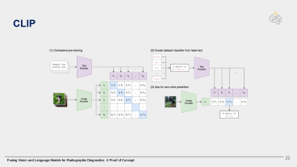
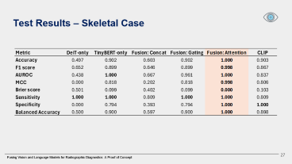

Slide 20
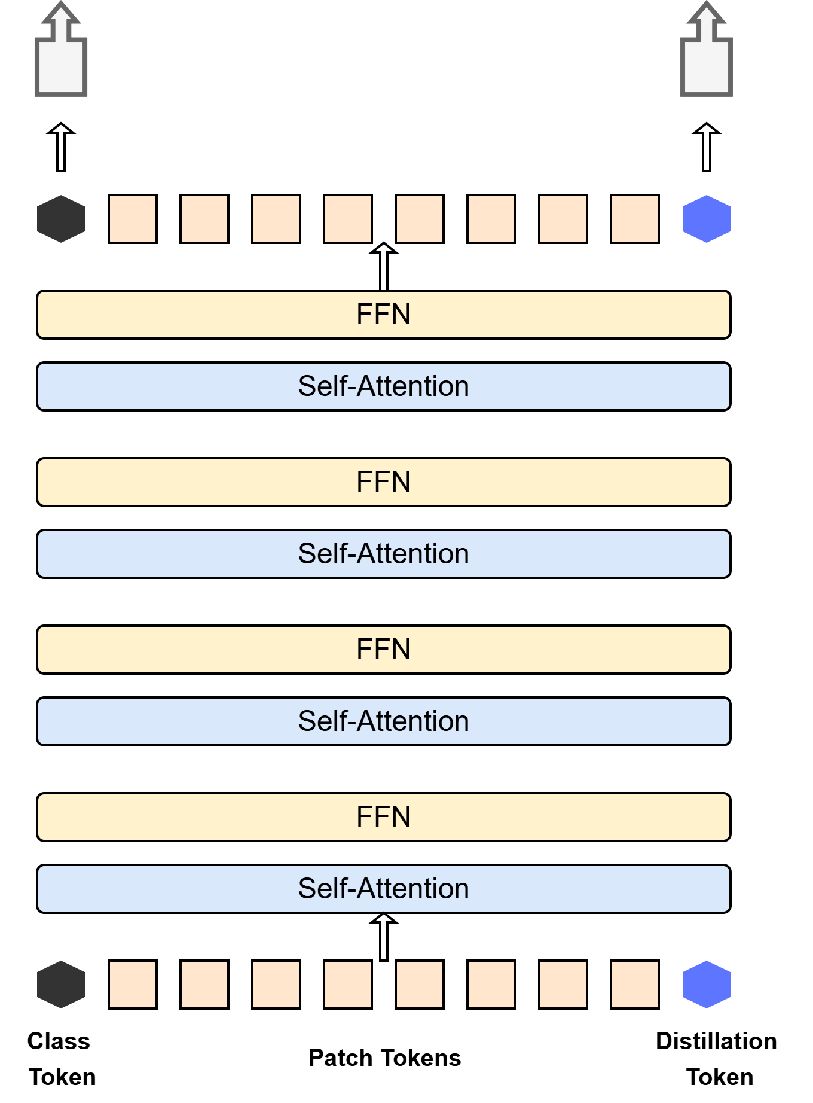
DeiT Architecture

Slide 21
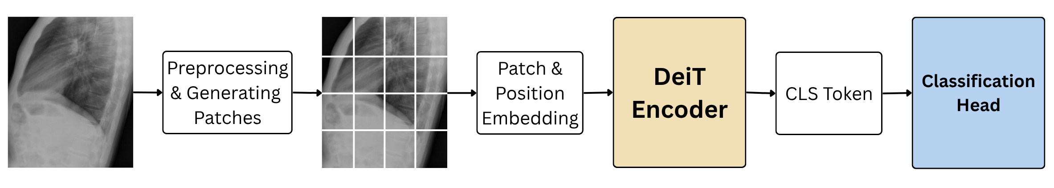
DeiT Pipeline

Slide 22
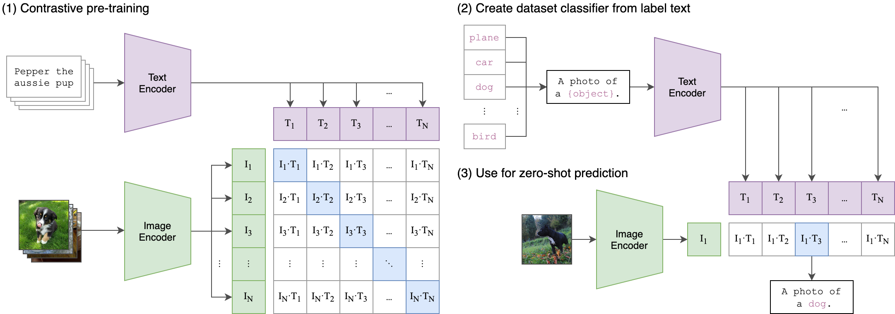
CLIP

Slide 23
Train Results – Chest Case

Slide 24
Test Results – Chest Case

Slide 25
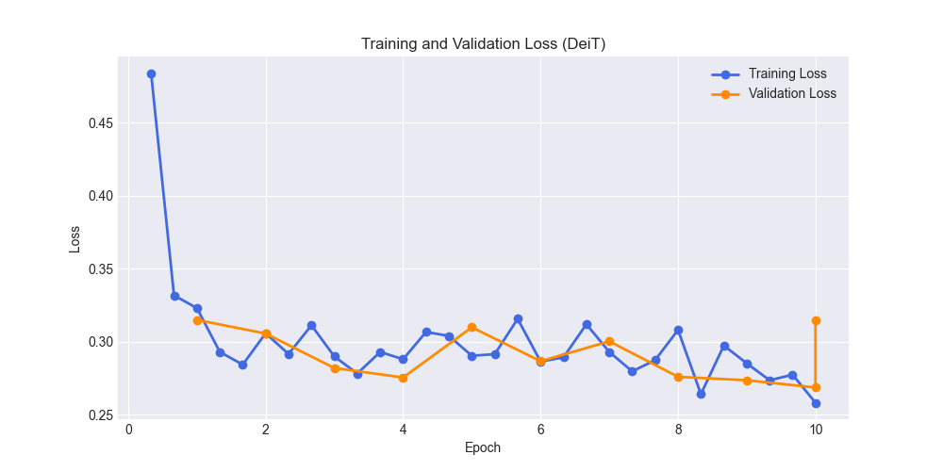
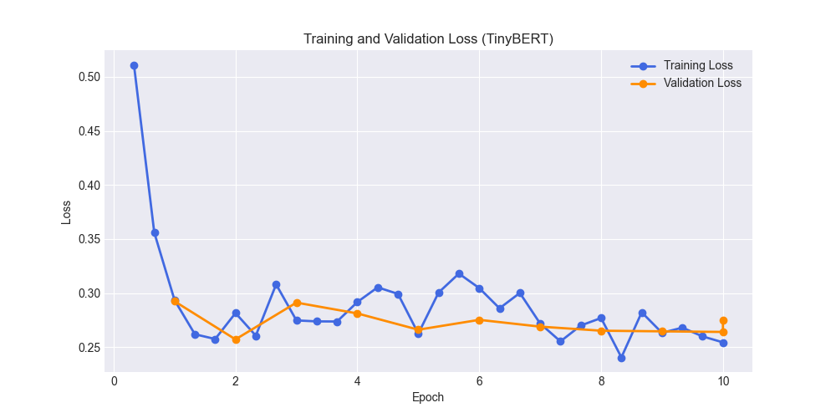
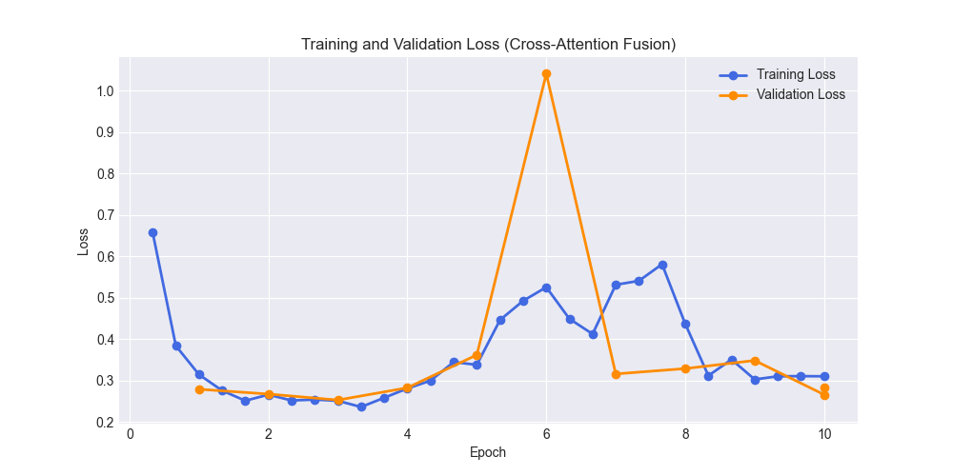
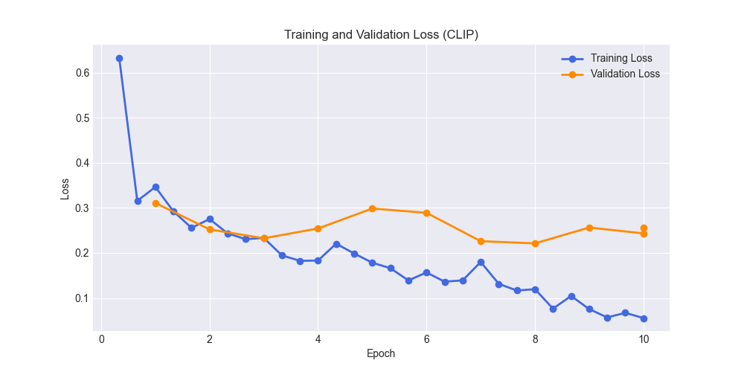
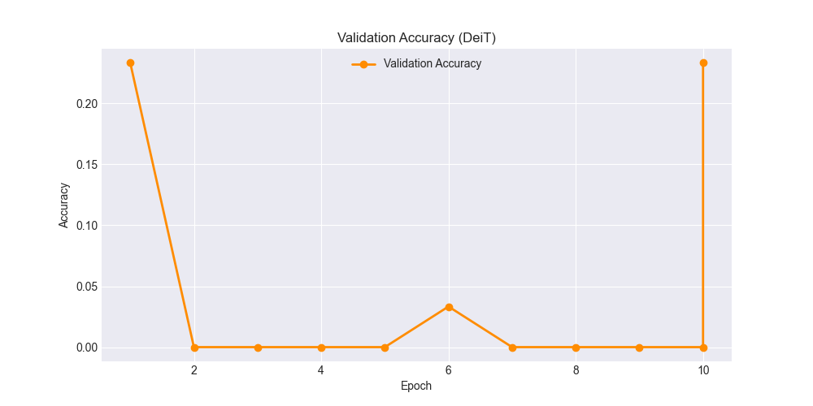
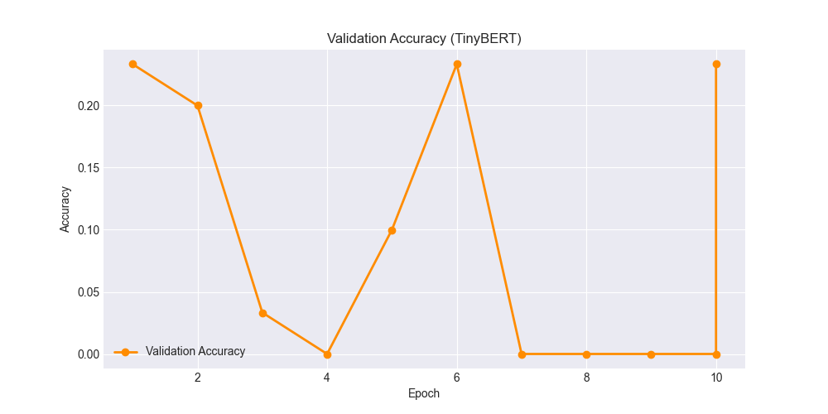
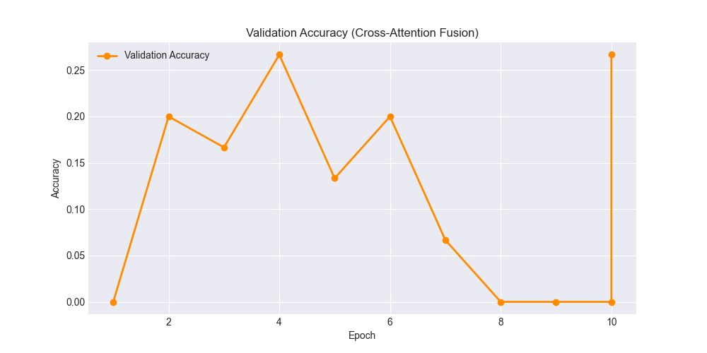
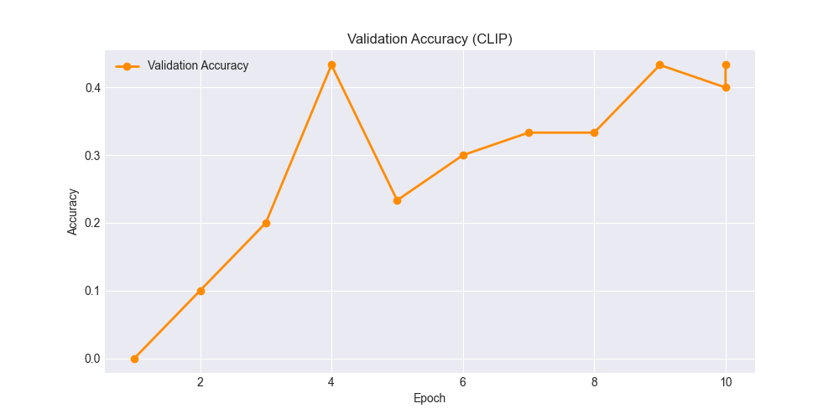
Loss & Accuracy Curves – Chest Case
Loss
Accuracy
DeiT
TinyBERT
Fusion
CLIP

Slide 26
Train Results – Skeletal Case

Slide 27
Test Results – Skeletal Case

Slide 28
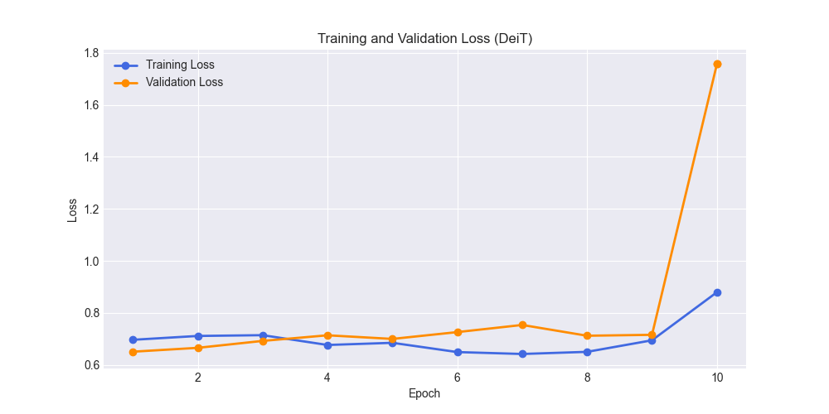
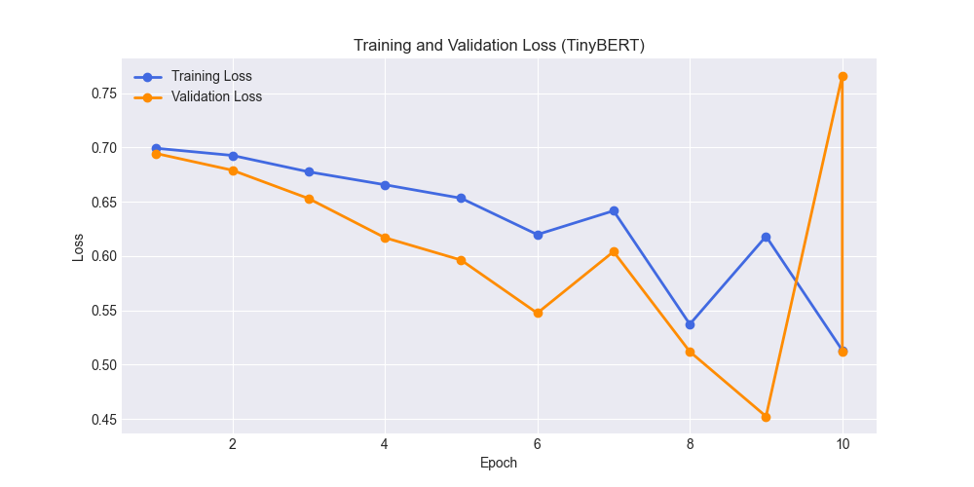
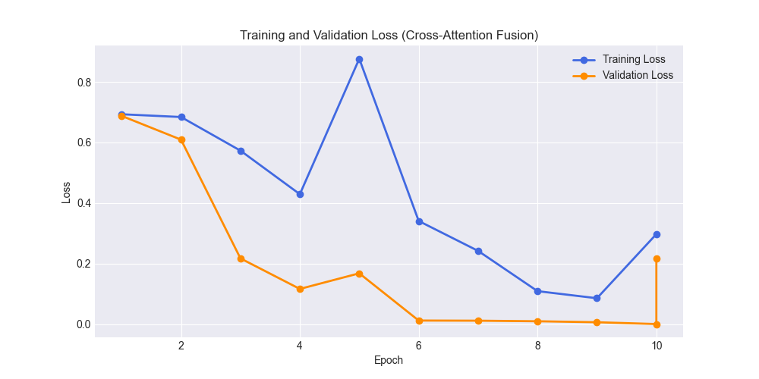
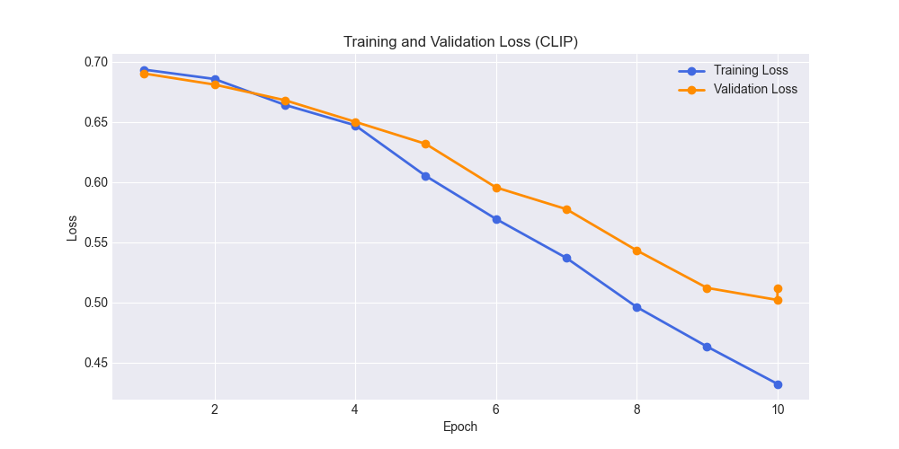
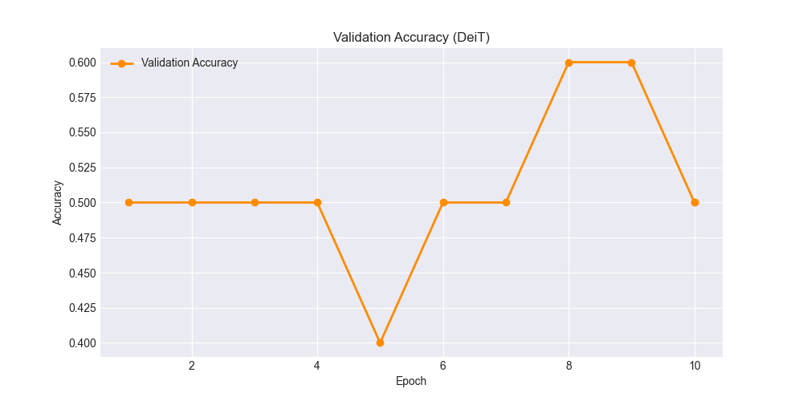
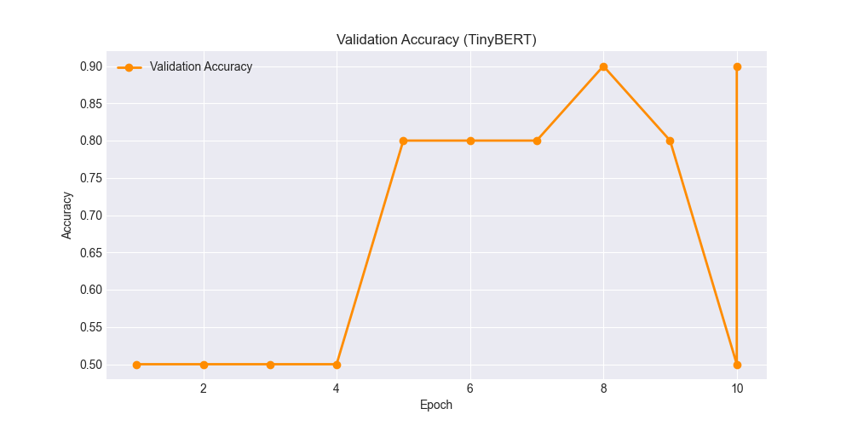
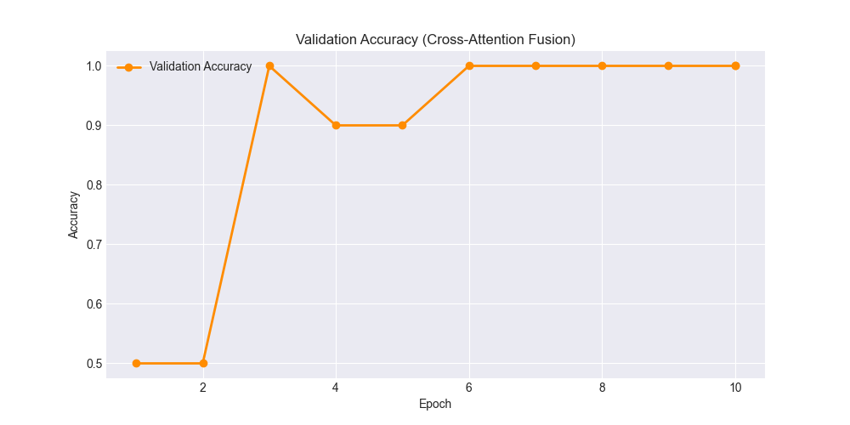
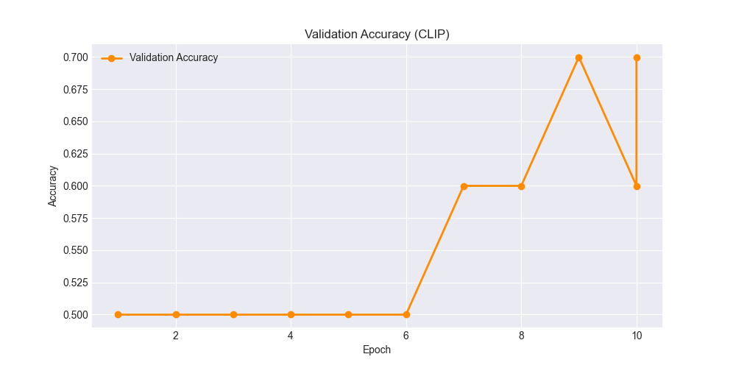
Loss & Accuracy Curves – Skeletal Case
Loss
Accuracy
DeiT
TinyBERT
Fusion
CLIP

